Slide 1
Technology and customer relationship
Submitted to: Dr. Meghna Verma
Submitted By: Fahad/Mrinal

Slide 2
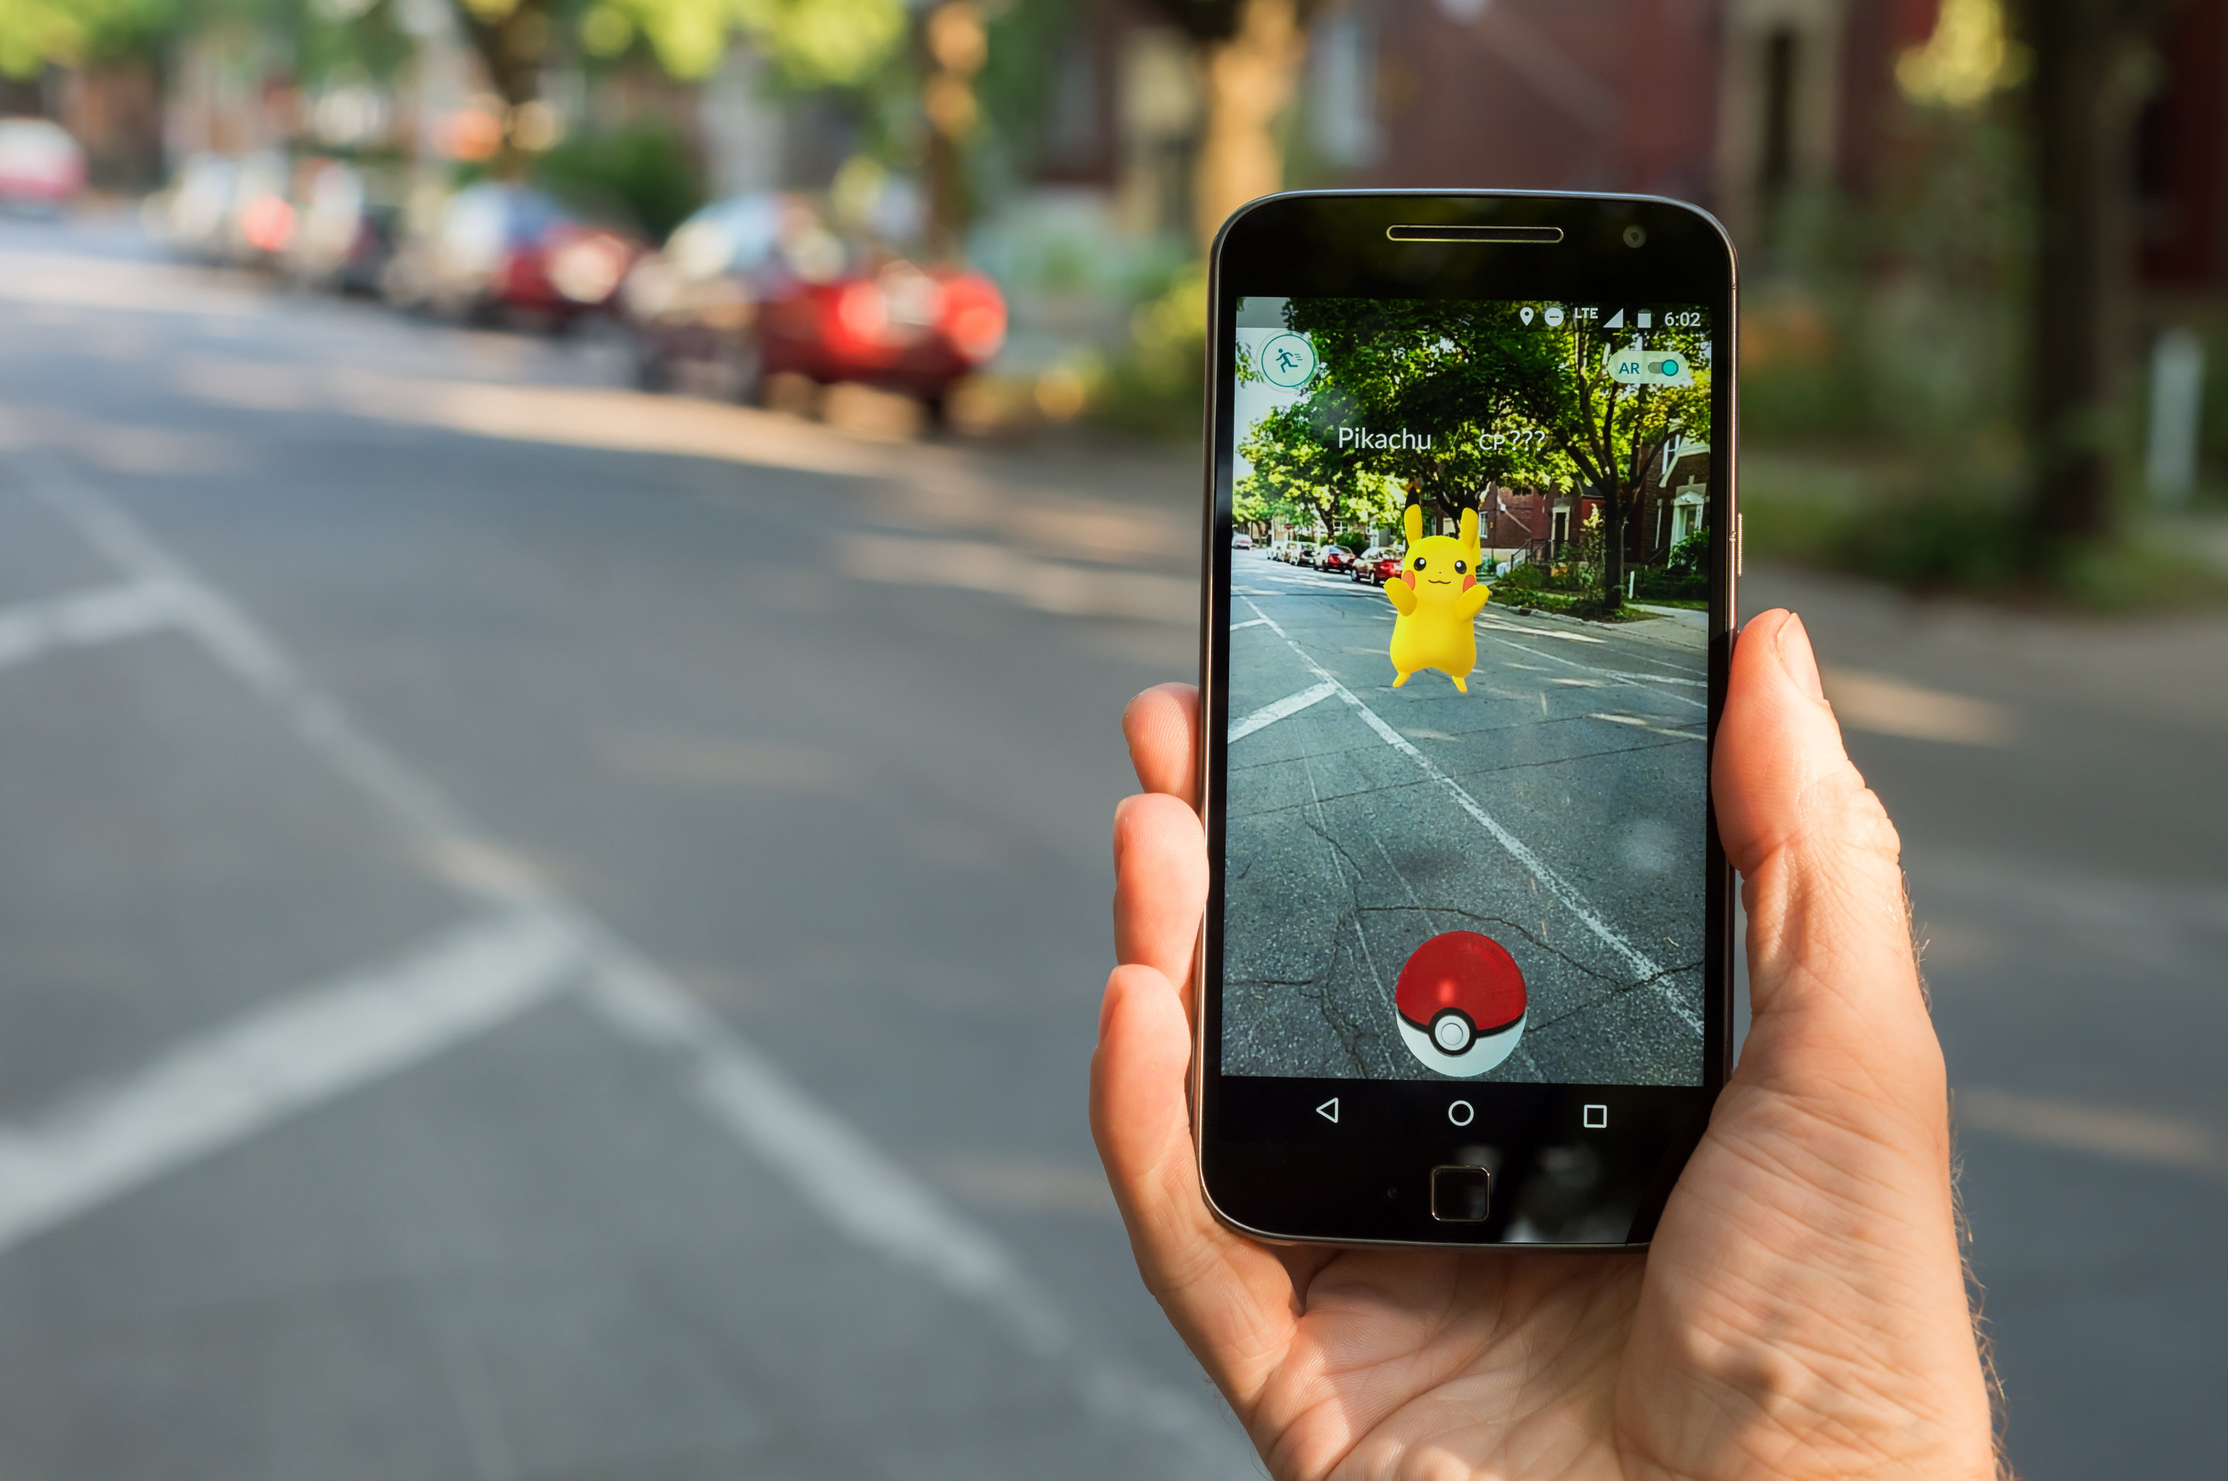
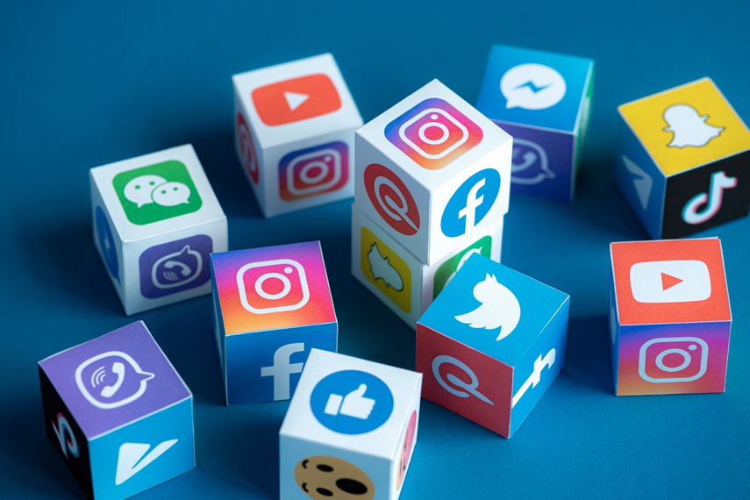
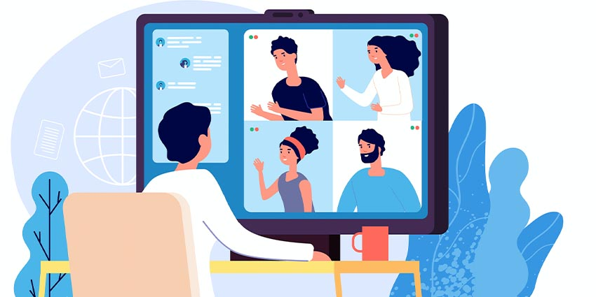
Ways to connect to a customer
AR/VR
Social Media
Video Conferencing

Slide 3
AR/VR
61%
Of shoppers prefers retailers that offer AR over those who do not
As human beings, we base our perception of the world on the rules developed by our experience. We believe what we see, hear, and feel around us. Both VR/AR designers use the basic rules of perception, and ideas of how we interact with the world to create environments that feel just as authentic as the world around us.
71%
of shoppers said that they would shop more often if they could use AR
40%
of shoppers said that they are ready to pay more for a product if they were able to test it through AR first.
Source: Eclipse “How is augmented reality Impacting retail”

Slide 4
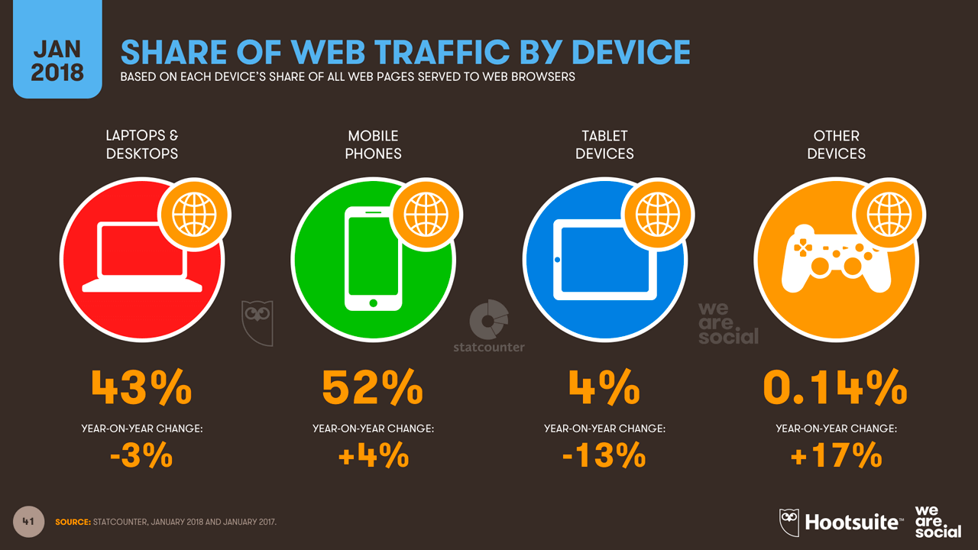
Social Media
We can use social media to build customer relationships is by rewarding them with giveaways, promotions, coupons and contests.
Giveaways and contests are great social media marketing opportunities that can generate a lot of buzz, placing your brand at the top of the daily trending lists and encouraging more visitors to seek out your website.
One popular way to spread your brand’s story on social media is to ask your followers to share your message with three friends to enter a contest.
Source: 2016 B2C Content Marketing Trends North America

Slide 5


Video Conferencing
Every enterprise owner, desires to minimize costs and maximize returns. Have you ever realized that communicating with agents, customers, employees and even your partners grab you large sums of money thereby reducing your profit margins?! If yes, then video conferencing is exactly what you need to reduce your communication costs as it brings numerous benefits to businesses.

Slide 6
THANK YOU

